Slide 1
Kitchen Contractor
Build your dream kitchen
Adam Grabowski - IW 105 Spring 2017
Advisor: J.P. Singh

Slide 2
Motivation
Spent several summers working as a carpenter - noticed many inefficiencies
Role of General Contractor
Small projects
No specialized knowledge
Management ability
Consistent steps
Scope of project

Slide 3
Goal
Give homeowners the ability to fulfill the role of General Contractor on kitchen renovation projects, allowing for greater control and monetary savings

Slide 4
Related Work
Angie’s List
Rate services in their communities
No project planning features
Home Advisor
Connects users to contractors
No project planning features
Building Guide
general advice for home builders, and sourcing contractors
very general, specific to NZ

Slide 5
Approach
Capture the scope and specifics of a construction project
Translate into building plan
Outline steps
Contractors
Source contractors on the platform
Ratings - reliability
Eliminates need for General Contractor
Creates plan
Provides contractors

Slide 6
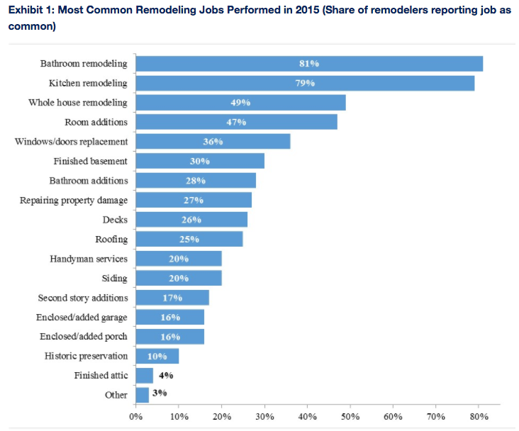
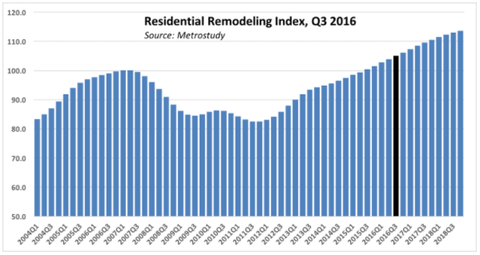
Customers and Market
$18.2 billion on kitchen renovations last year
Average cost of remodel : $17,000 - $37,000

Slide 7
Customer Acquisition
Contractors
Union organizations
Referral rewards
Word of mouth industry
Free trial
Home-owners
Targeted advertising
Magazines, websites
Referral rewards

Slide 8
Revenue and Pricing
Business Model
Homeowners
Free
Contractors
Monthly subscription
Growth first
Ads
Sponsorships - feature products
Revenue:
Initially low
Reduce variable costs - referral rewards/raffles

Slide 9
Implementation
Build a MVP website that would allow users to plan and manage a kitchen renovation
Focus solely on steps, not project design
Using: Flask, Javascript, CSS, HTML, SQLAlchemy
To create a new project:
Questionnaire about scope of renovation
Outline of required steps to take
Search and source contractors for the project
Manage project from project page

Slide 10
Results
Survey information from various homeowners
Functionality
Ease of use
Survey general contractors
Accuracy/correctness of the plans
What details should additionally be taken into account

Slide 11
Conclusions
Capturing the scope of a construction project makes it possible to translate it to straightforward steps
Consistent steps in construction process
Contractors require specialized knowledge - manager does not
Platform has the potential to resolve the need for a general contractor on small scale projects
Saves homeowners money
Added control

Slide 12
Future Work
Different types of renovations/projects
Closer work with an experienced general contractor
More accurate project plans
Incorporate building codes and construction laws
Vary depending on place

